Slide 1
Java Training – Part 2
Trifan Alexandru
Full Stack Developer

Slide 2
Part 2 – Fitnesse
About Fitnesse
FIT & SLIM
Writing tests
Writing fixtures

Slide 3

About Fitnesse
Testing method
Testing tool
Software tool
Community/industry/philosophy/automation
Black Box Testing mainly / yet used as white box testing as well

Slide 4

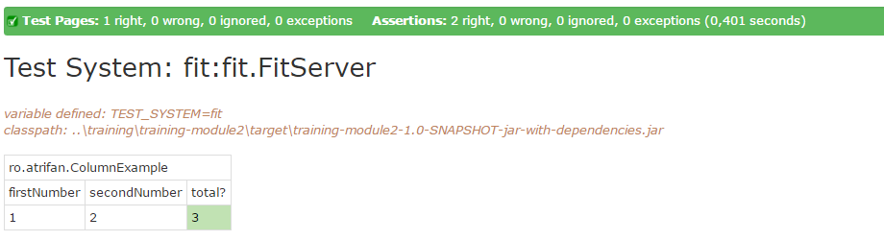
It’s all about tables & WIKI
Writing a test
Testing the test
assert | x | y

Slide 5

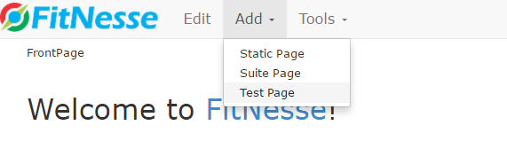
So how to start?
Run fitnesse standalone
Enter fitnesse server
Start a test/suite/documentation
Design the test

Slide 6
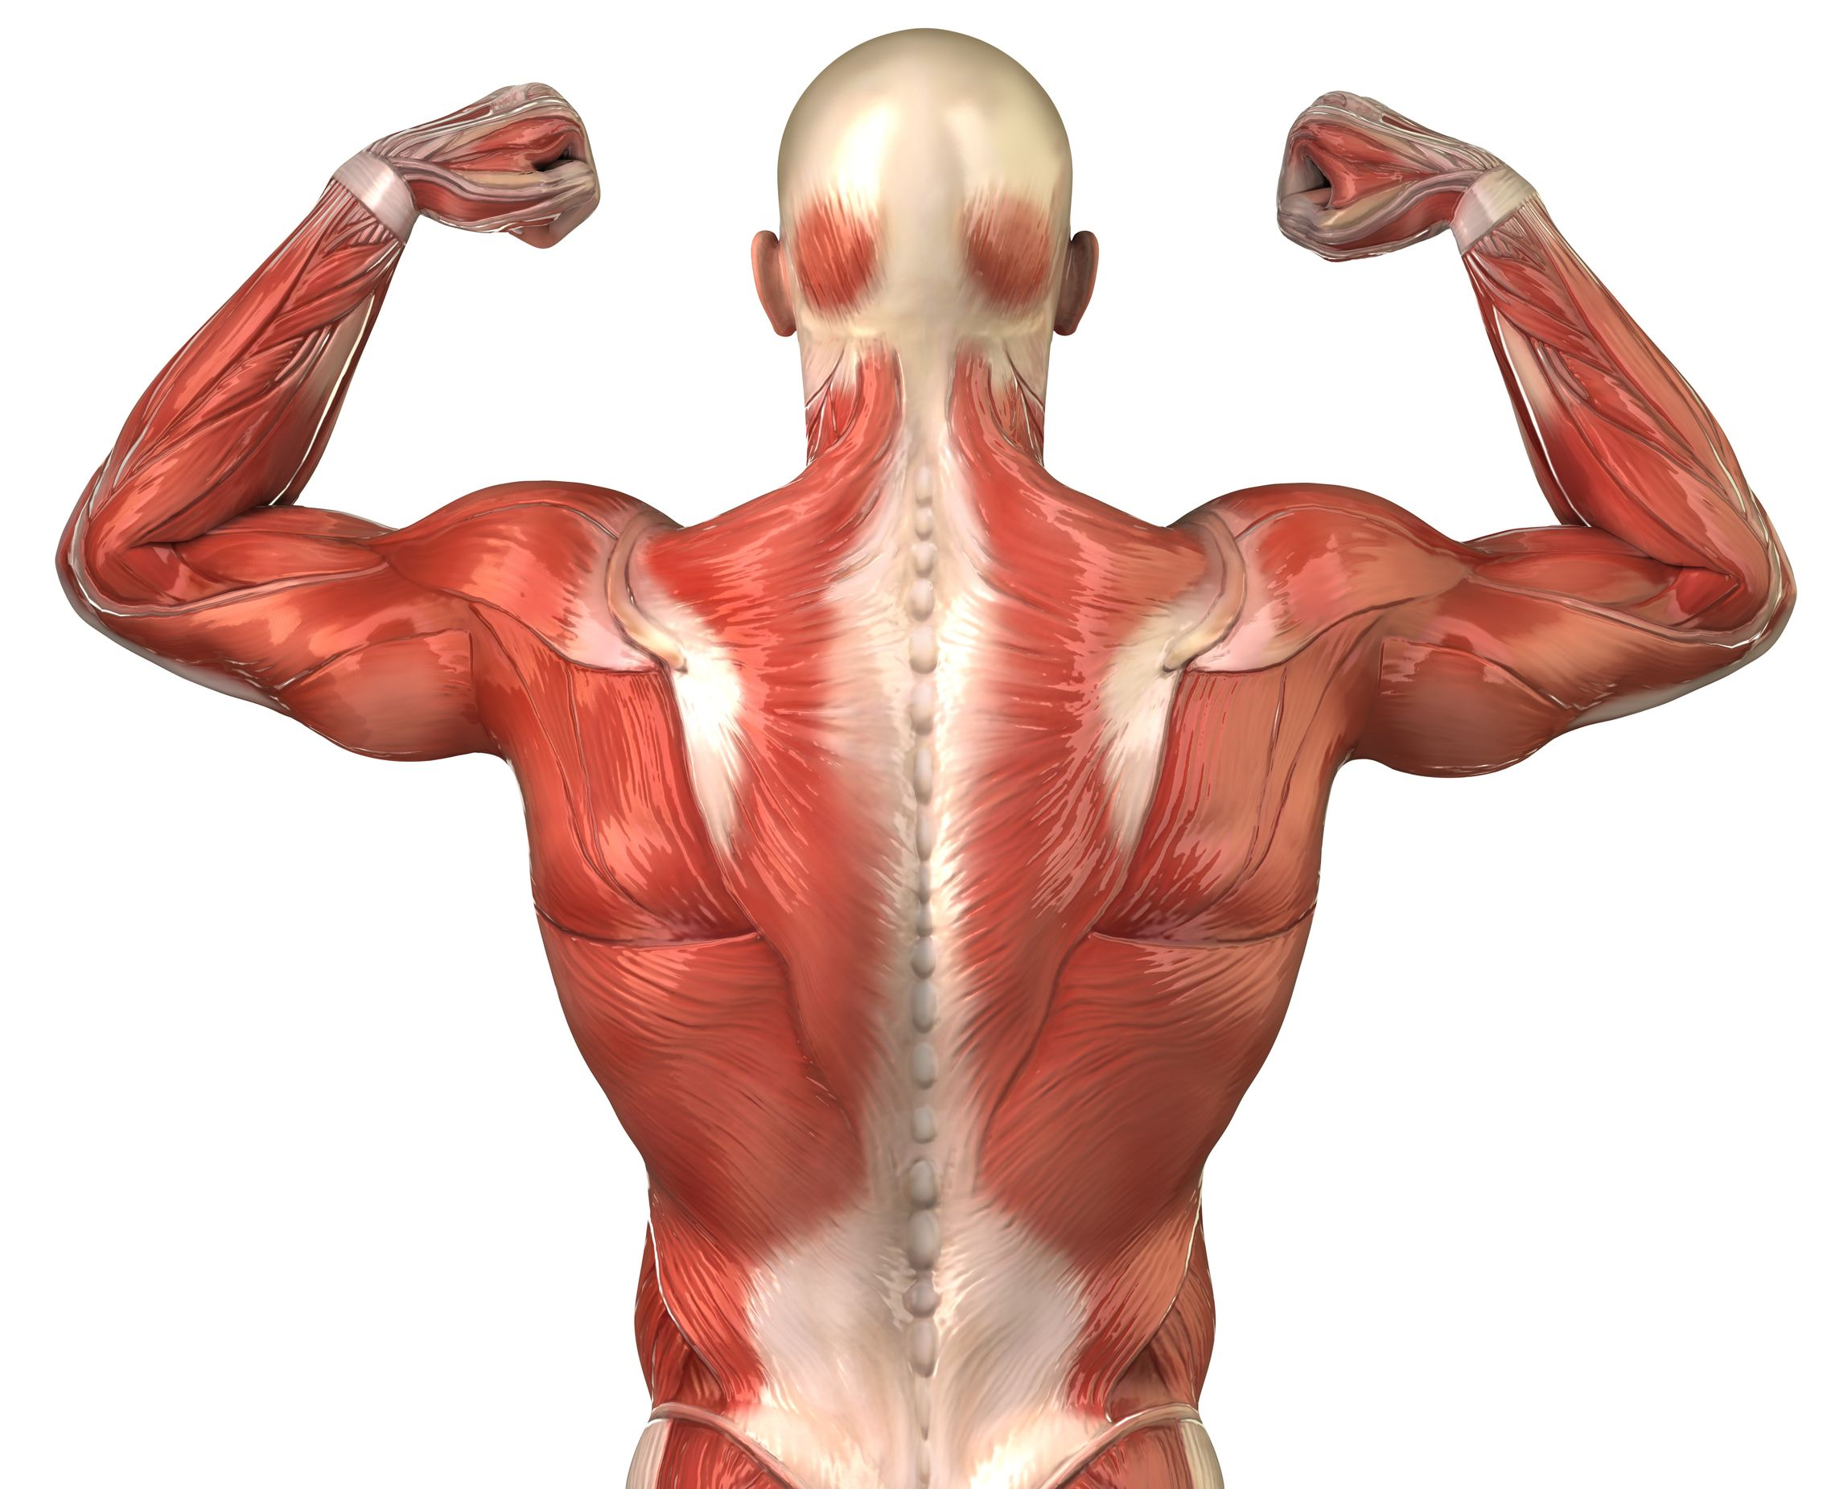

FIT & SLIM
Powerfull testing framework, all
muscles
Speedster, fibers, flexible, framework, does exactly what you need it and fast.

Slide 7
Basic testing knowledge - designing
Separator : ``|``
Including a jar: ``!path ..\training\training-module2\target\training-module2-1.0-SNAPSHOT-jar-with-dependencies.jar``
The table header(aka the main class or the title):
Main class: ``!|ro.atrifan.ColumnExample |``
Title: ``|Action Fixture |``
Principles: based on | action | value | otherValue |

Slide 8
Fixtures
Column Fixture
Action Fixture
Custom Fixture
! Disclaimer: There are many more fixtures out there, I choose only this 3 types because I thought it was more than sufficient to grasp it.

Slide 9

Column Fixture
Fit type fixture
All setters and an assertions

Slide 10
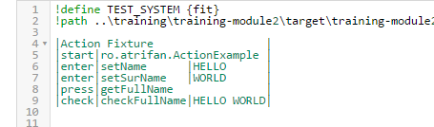
Action Fixture
FIT type fixture
Possible actions
start - class
enter – calls function with value – this should be setter functions
press – calls function – ussualy this should be an execution function
check – calls function – and compares it with the 3rd column – expected output

Slide 11
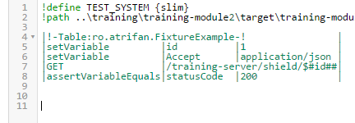
Custom Fixture
SLIM type fixture – powerfull, but needs advanced knowledge like reflection
Unlimitless possibilities
Calls your doTable method from your class, next is up to you (displaying data, figuring out wrong from right, run functions based on text)
Possible actions (anything)

Slide 12
Questions?
Thank you!
Access: https://github.com/atrifan/shield_training/blob/training_part2/README.md

